Slide 1
SMART SEARCH
PROD MODE
WORKFOW MANAGER

Slide 2


Slide 3
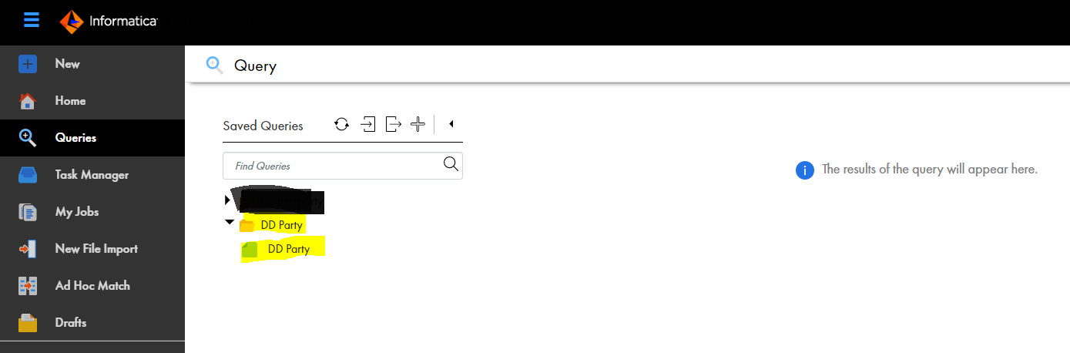
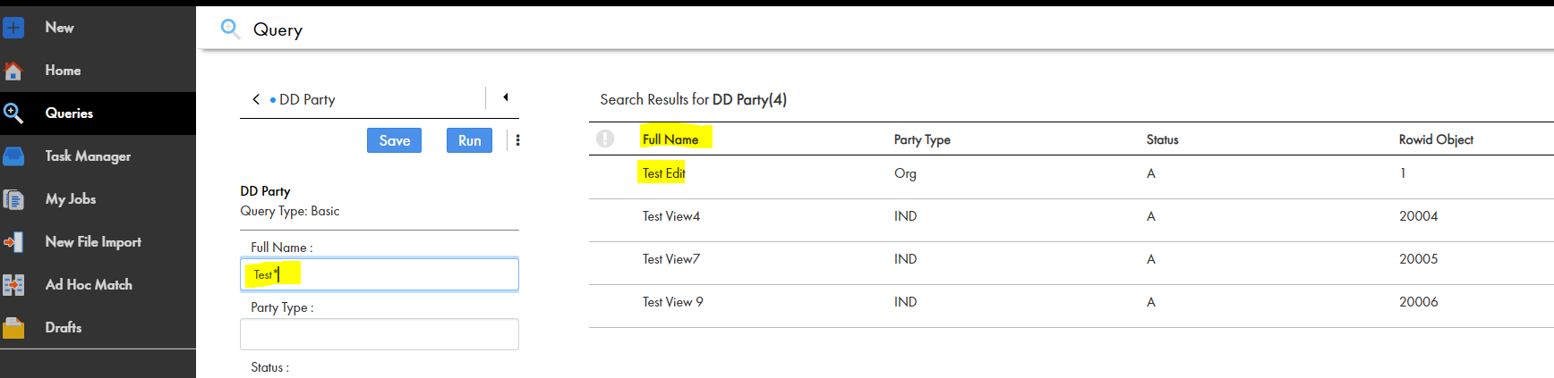
Traditional MDM Query process

Slide 4
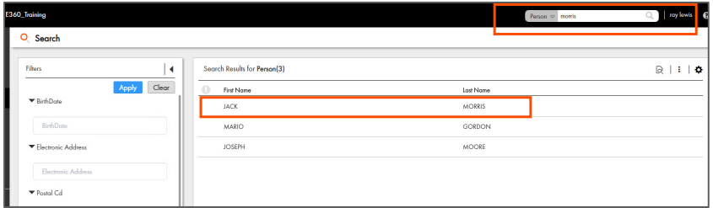
Using smart search you can search a record by its keyword and form different BE at same time

Slide 5
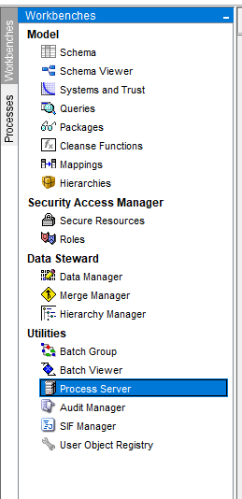
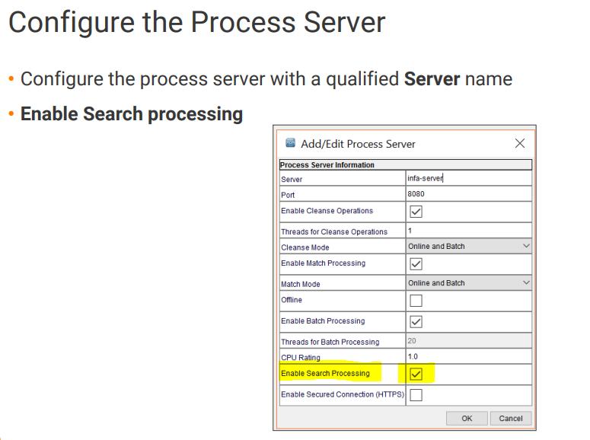

Slide 6
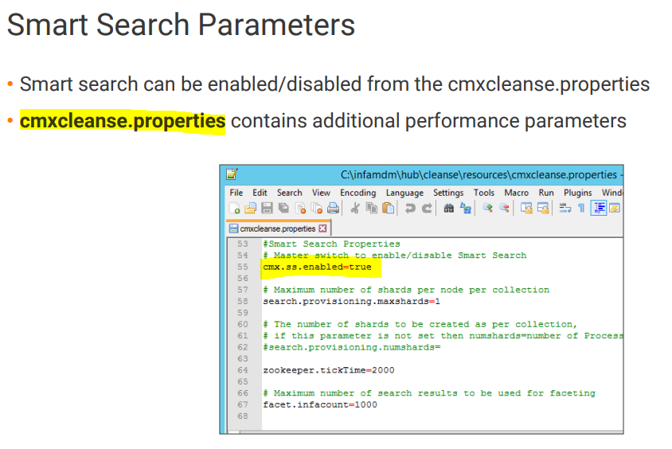

Slide 7
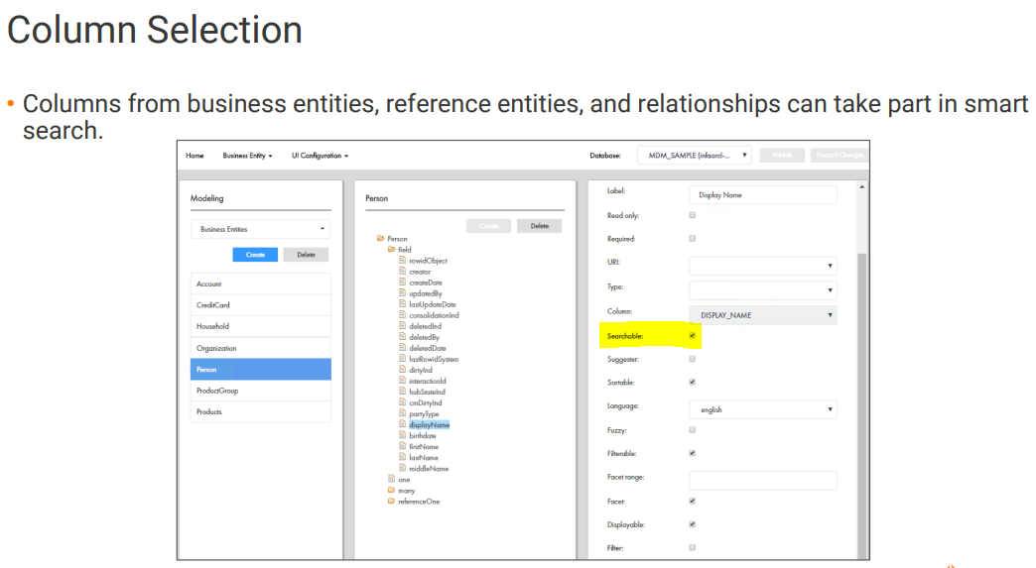

Slide 9
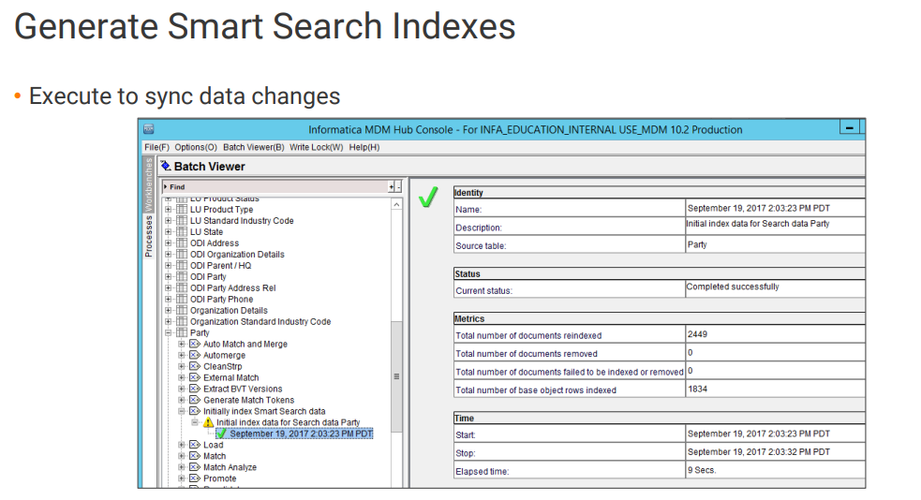

Slide 10
ORS: PRODUCTION MODE

Slide 11
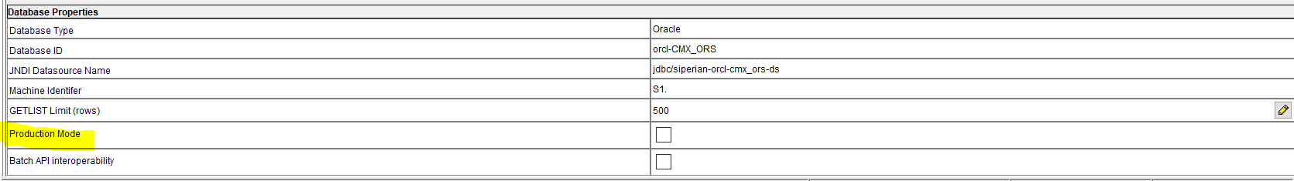
If PROD Mode is enabled then we cant do any changes in hub console and PT

Slide 12
WORKFLOW MANAGER

Slide 13
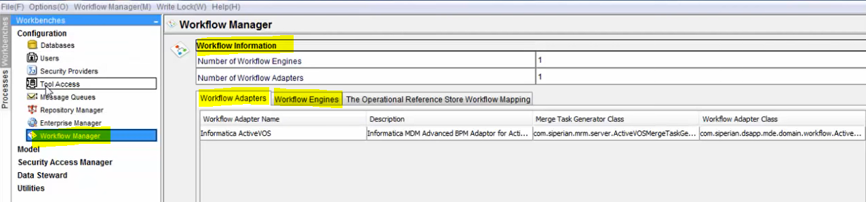
Workflow manager used to setup workflow engine.
Workflow Manager → Workflow Engine → Select ActiveVOS engine.

Slide 14
CORE MDM COMPONENT

Slide 15
Hub Console
Configuration
Model Workbench
Match & Merge
Hierarchy
Provisioning Tool
Workflow
E360

